Slide 1
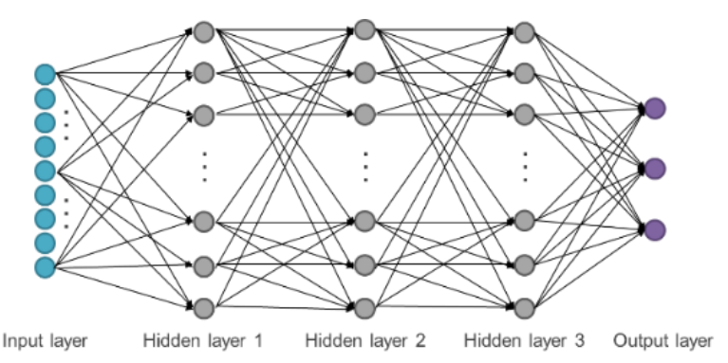
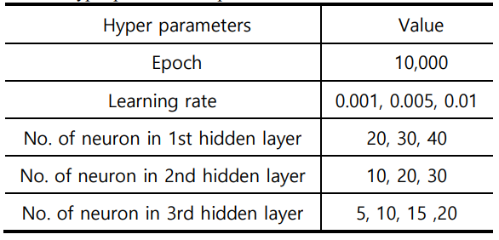
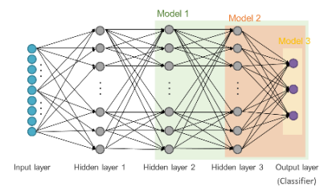
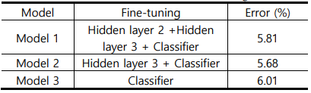
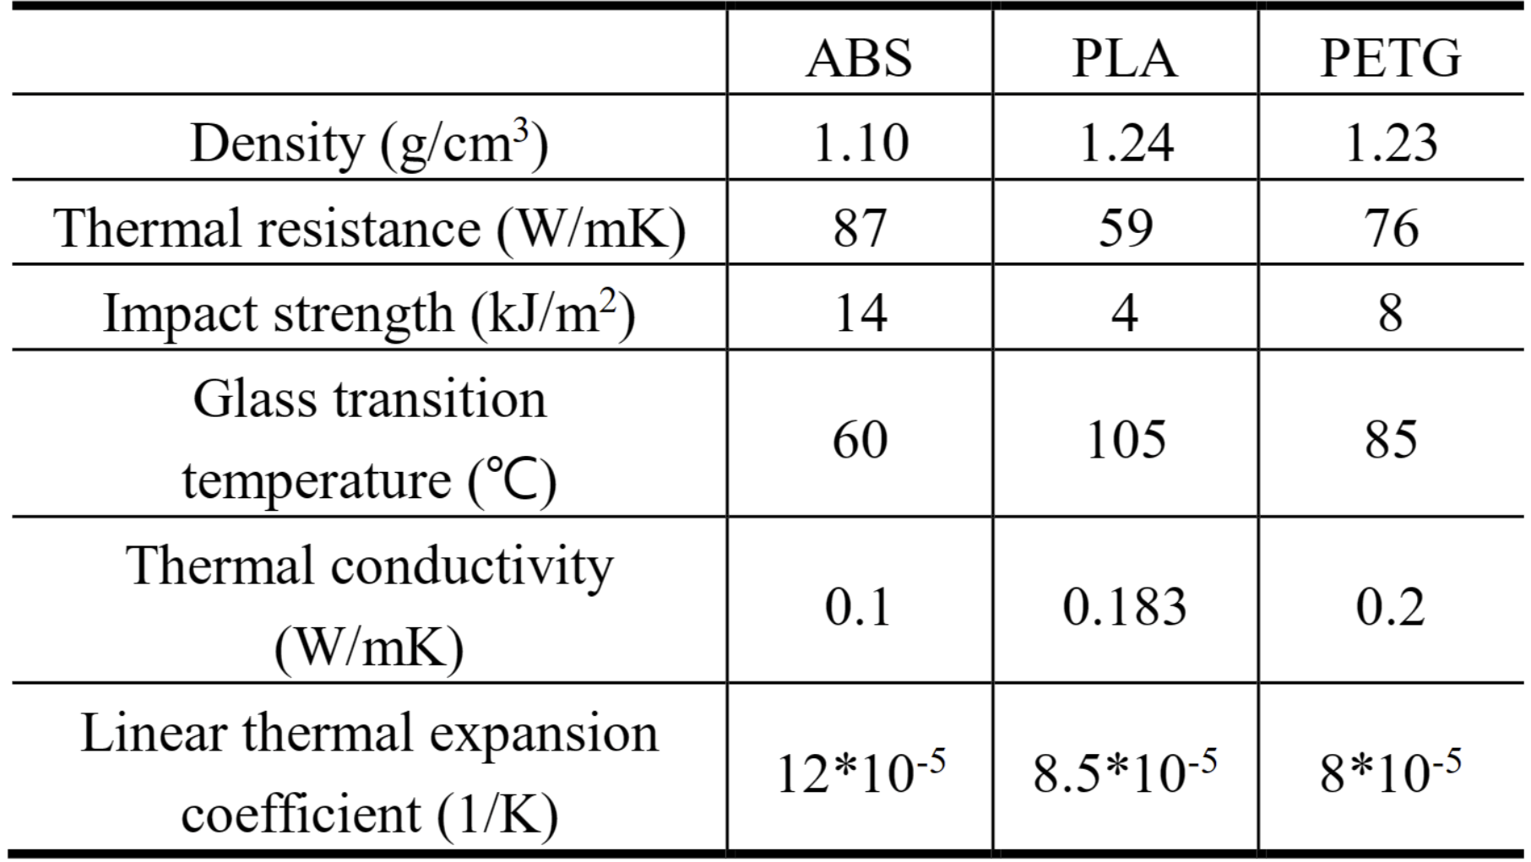
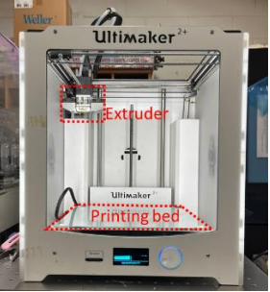
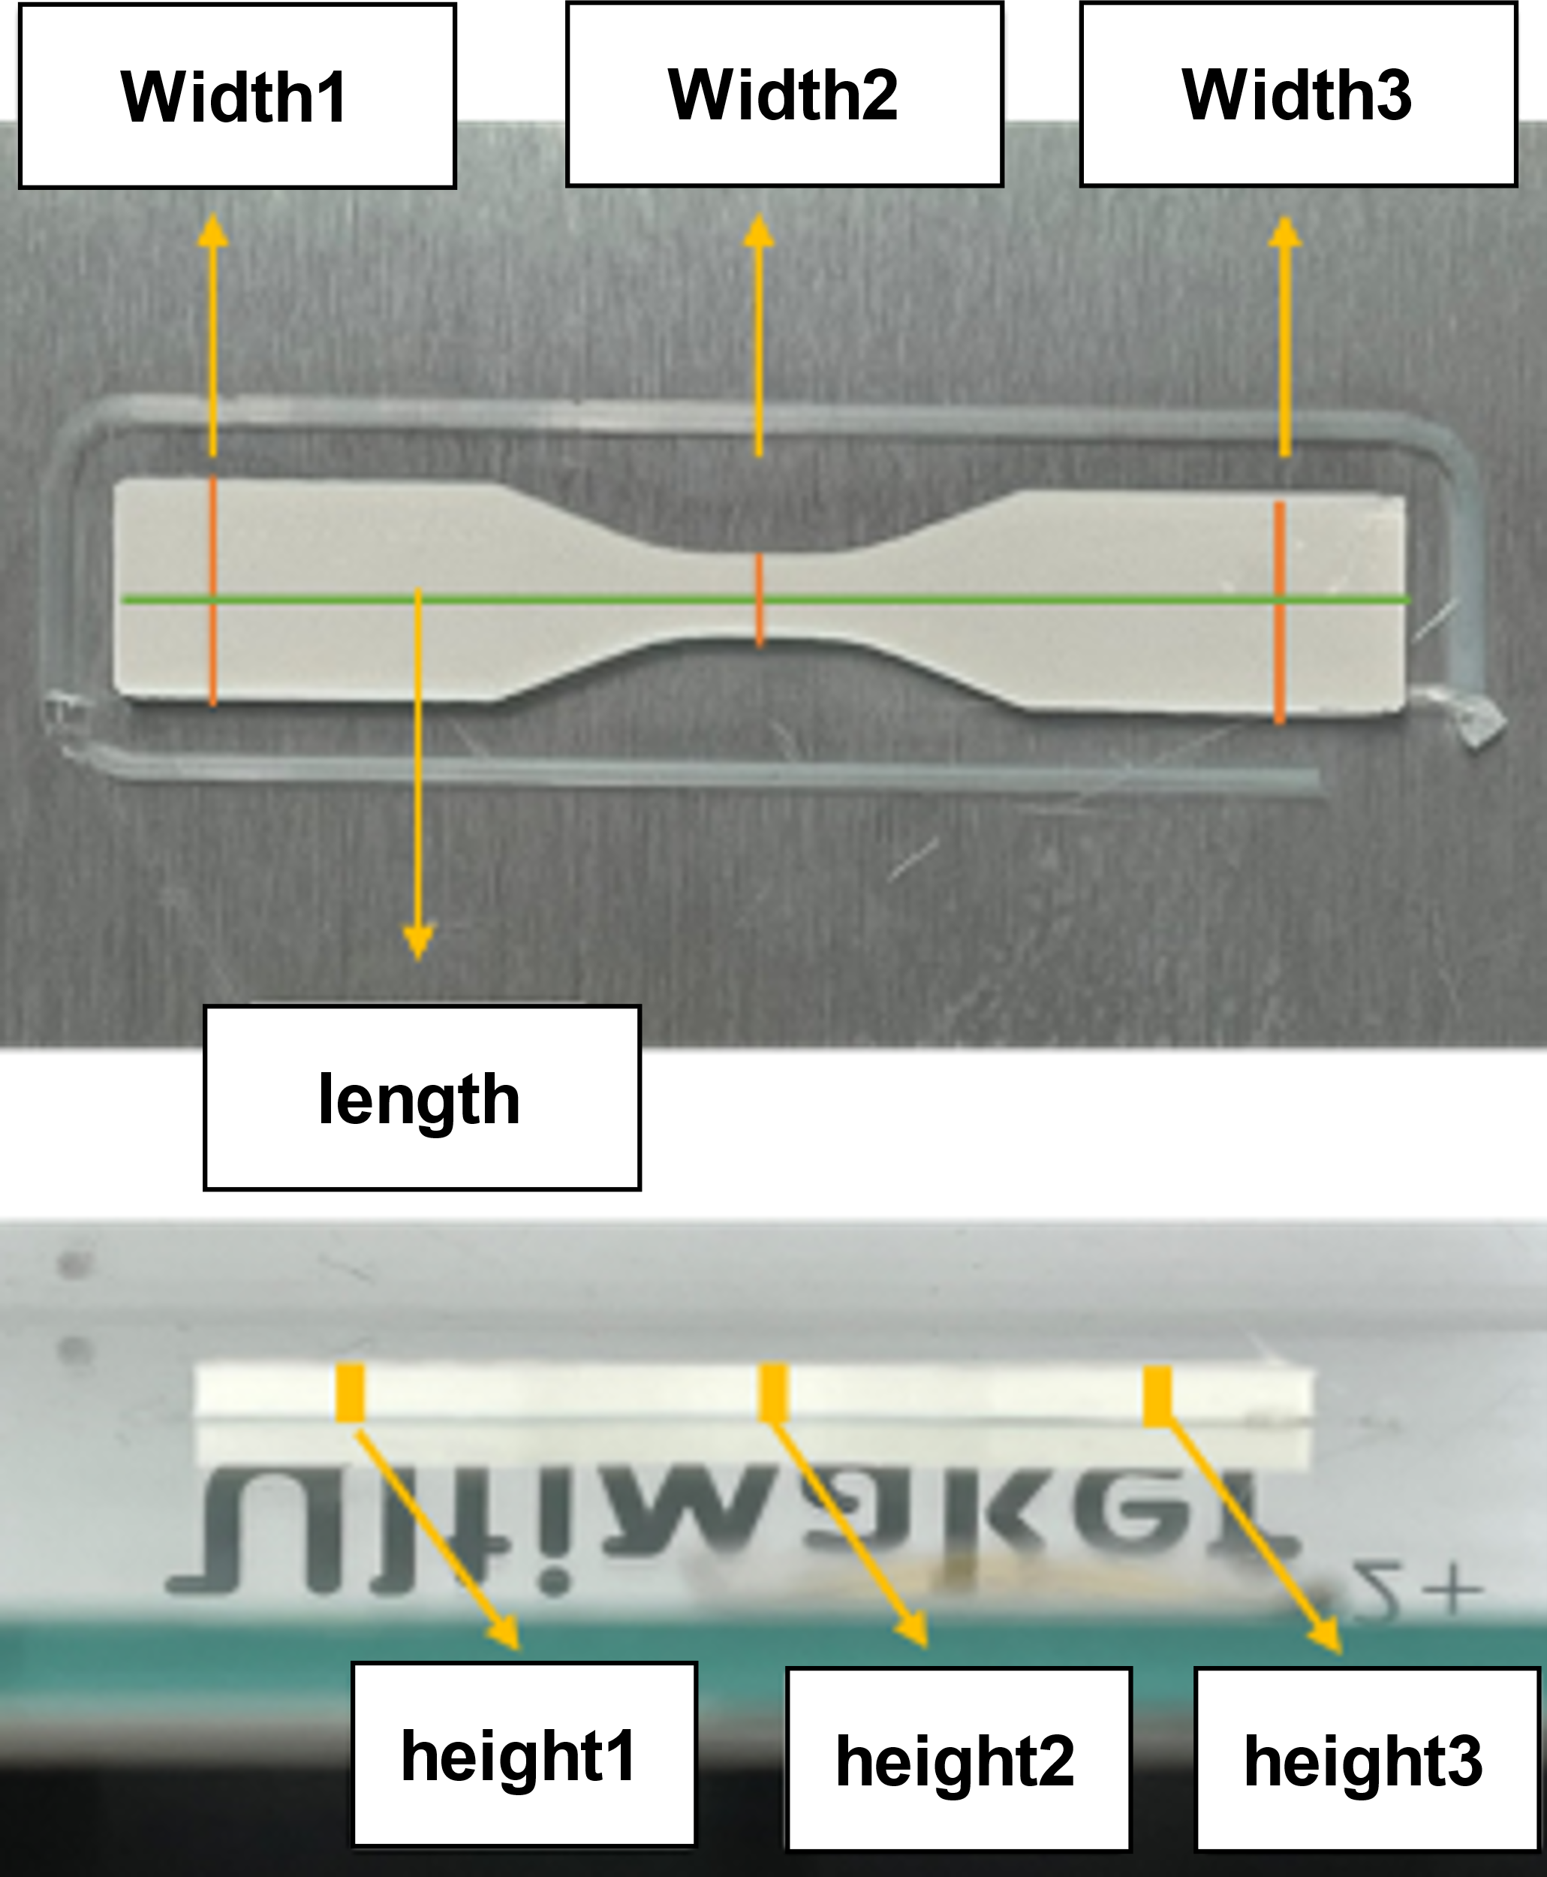
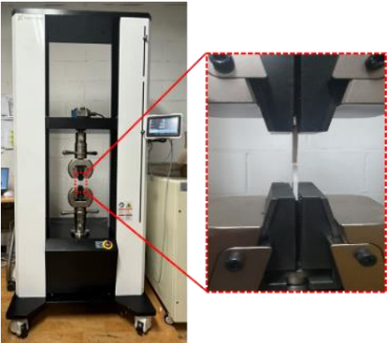
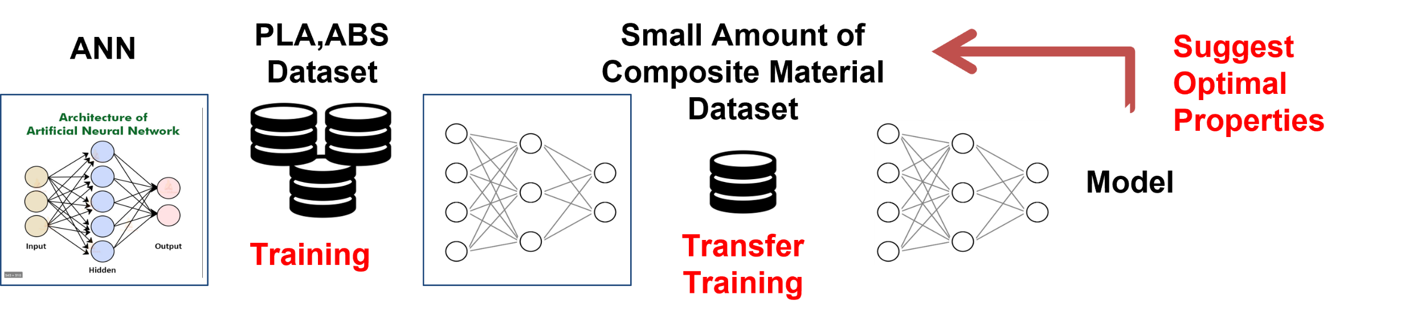
Development of an ANN and Transfer Learning-Based Quality Prediction Model in the Fused Deposition Modelling (FDM) Process
S. B. Choi*, B. C. Kim*, J. W. Seo*, C. Ahn*, H. Shin**, U. Cho**, S. W. Lee*†
* School of Mechanical Engineering, Sungkyunkwan Univ., Suwon, Republic of Korea
** Department of Mechanical Engineering, Sungkyunkwan Univ., Suwon, Republic of Korea
† Corresponding Author: sangwonl@skku.edu
Motivation and Background
Quality Prediction Modeling
▪ Importance of FDM Quality Prediction in Composite material
- Composite material FDM research ongoing across various industries
- Quality prediction models needed for efficiency and cost savings
- Current research only predicts quality for single materials → Need a quality prediction model for FDM using composite materials
▪ Data scarcity issue in the use of composite materials
- Numerous combinations based on the proportion of constituent materials
- Generating data for all combinations is challenging
→ Additional methods are needed to address the data scarcity issue
▪ Pre-Training model using PLA and ABS (Base-model)
- Model structure: input layer(9 node) - 3 Hidden Layers - output layer(3 node)
- Input layers: 3 process variables and 6 material properties
- Output layer: tensile strength, weight, and dimensional accuracy
- Data: ABS + PLA data, 8:2 Train-Test Split (train: 108+108, test: 27+27)
- Loss function: Each observed variable has a different dimension
→ MAPE for tensile strength and weight, MAE for dimensional accuracy
- Hyperparameters: number of neurons in each hidden layer and learning rate
- Conducted hyperparameter optimization using grid search (Error: 3.60%)
→ Best model: Learning rate = 0.01, N1 = 30, N2 = 30, N3 = 10
Objectives and Methods
▪ Development of Quality Prediction Model using TL
- Selection of materials for pre-training and transfer learning
- Selection of printing parameters, and parameter ranges
- Selection and measurement of observation variables to measure quantified quality
- Data collection using 3D printer and measurement tools
- Training a pre-trained artificial neural network model using data from two materials
- Transfer learning according to the number of trainable layers
- Test and selection of the optimal prediction model
Model Architecture of base-model
Hyperparameters for base-model
▪ PETG Quality Prediction Model using Transfer Learning
- Data: PETG data, 2:1 Train-Test split (train: 16, test: 8)
- Making 3 transfer learning model according to number of trainable layers
→ Hidden layer2,3 + Classifier vs Hidden layer3 + Classifier vs Classifier
- Fine-tuning and validation for each model
- Best model: Hidden layer3 + Classifier (Error: 5.68%)
→ Similar performance to the base-model with 24 small data sets
Experiment and Data acquisition
▪ Experimental setup for FDM process data acquisition
- Material: ABS and PLA (for base-model), PETG (for transfer learning model)
- Observed variable: Dimensional variation, Tensile Strength, Weight
- Process variables: bed temperature, extruder temperature, layer thickness
- ABS, PLA (3 factor 3 levels = 27case), PETG (2 factor 3 levels = 8case)
Fine tuning for each transfer learning model
The performance for each transfer learning model
Conclusions and Future Works
▪ Conclusions
- Established process parameters for ABS, PLA, PETG and conducted printing
- Developed a pre-trained model using data from ABS and PLA (Error: 3.6%)
- Enhanced and validated the pre-trained model using transfer (Error: 5.68%)
→ Built a robust model capable of predicting quality with limited data
▪ Future works
- Exploring the potential to apply the same method to other materials beyond PETG
- Generate quality prediction data based on this model
→ Develop a model suggesting optimal material properties based on
quality prediction data
Material properties of ABS, PLA and PETG
Case setup using full factorial design
▪ Experimental Data Collection and Measurement
- Use a 3D printer to print ABS and PLA 5 times, PETG 3 times
- Measurement of Dimensions, tensile strength, and weight
- Convert dimensions to one average relative error per measurement point
- Collecting 294 experimental data: PLA (135), ABS (135) and PETG (24)
3d-printer
Measurement point
test machine for tensile strength
Model framework of Physical Property Suggestion Model
8

